Slide 1
Databases and
Entity Framework

Slide 2
Agenda
Introduction to database design & indexing / performance concepts
Introduction to ADO.NET
Introduction to Entity-Framework (Connection String, DbContext, Migrations)
Introduction to Models (POCO classes) and Model Inheritance
Create, Read, Update and Delete (CRUD) operations with Entity Framework
Sorting, Paging and Grouping with LINQ
Handling concurrency & Transactions
SQL vs NoSQL

Slide 3
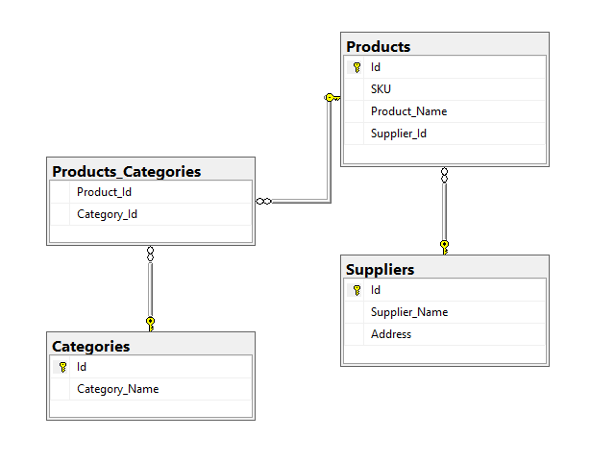
Introduction to database design & indexing concepts
Consider the following database schema:
Table Products has a one-to-one relationship with table Suppliers (one product can relate to one supplier).
Table Products has a many-to-many relationship with table Categories (one product can relate to one or more categories). Table Product_Categories is also called a “Weak Entity” (an entity without a primary key).
You should always normalize data as much as possible to ensure that there are no duplicate information on your database.
All Primary Keys (Id columns) are indexed by default.
You can add additional indexes on any column (or combination of columns - SKU column for example).
Beware that when you add Indexes, INSERT, UPDATE and DELETE operations get additional overhead (due to indexes maintenance).

Slide 4
Introduction to ADO.NET
Before diving into the world of Entity Framework, let’s see how a traditional ADO.NET database connectivity works. The steps for working with ADO.NET are:
Create a new SqlConnection by utilizing a Connection String → utilize the using structure in order to appropriately dispose objects. The database must exist before making any operations (most usually manually created via SQL)
Connection String defines the connectivity information between the application and the database. There are many kinds of Connection Strings depending on the database type, version, driver etc.
Perform the Database operation required (SELECT, INSERT, UPDATE, DELETE)
For INSERT / UPDATE / DELETE operations, it is advisable to use SqlCommand with Parameters, to avoid SQL Injection security flaw (e.g. creating the actual SQL Statement by concatenating strings)
For SELECT operation, we are using an SqlDataReader object to iterate through the returned records. Please note in our example that we map each database field to the appropriate object property (something that Entity Framework does automatically!)
After the operations complete, make sure you close the SqlConnection to free-up database resources.
In our example, we are demonstrating a simple CRUD Console application that works with ADO.NET (System.Data)

Slide 5
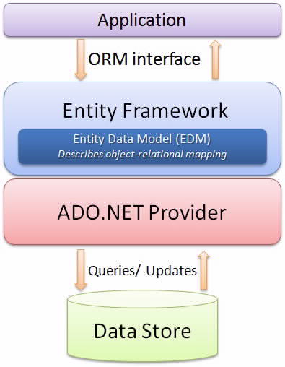
Introduction to Entity Framework
Entity Framework is an Object Relational Mapper (ORM). It basically generates business objects and entities according to the database tables and provides the mechanism for:
Performing basic CRUD (Create, Read, Update, Delete) operations.
Easily managing "1 to 1", "1 to many", and "many to many" relationships.
Ability to have inheritance relationships between entities.

Slide 6
Connection String and DBContext
Connection String defines the connectivity information between the application and the database. There are many kinds of Connection Strings depending on the database type, version, driver etc.
Typically, for an ASP.NET Core application, Connection String is stored in the appsettings.json file, like in the following example with SQL Server Express edition on localhost:
"ConnectionStrings": {
"DefaultConnection": "Server=.\\sqlexpress;Database=eshop;User Id =myusername;Password=mypassword;MultipleActiveResultSets=true"
}
On ConfigureServices method (on Startup.cs file) you either add the Db Context or (if you have selected Identity when creating your application it is already added like):
services.AddDbContext<ApplicationDbContext>(options =>
options.UseSqlServer(
Configuration.GetConnectionString("DefaultConnection")));
Your database context class must inherit DbContext or IdentityDbContext class. In an ASP.NET Core web application, DbContext is usually provided to other classes via dependency injection.

Slide 7
DBContext example (based on the previous tables)
public class ApplicationDbContext : IdentityDbContext
{
// Every model (besides the weak entities, must be declared with DbSet
// Weak entities, will be declared on the OnModelCreating function which
// will be overridden (this is the only way to define many-to-many
// relationships with EF)
public DbSet<Product> Products { get; set; }
public DbSet<Supplier> Suppliers { get; set; }
public DbSet<Category> Categories { get; set; }
public ApplicationDbContext(DbContextOptions<ApplicationDbContext> options)
: base(options)
{
}

Slide 8
DBContext example (continued...)
protected override void OnModelCreating(ModelBuilder modelBuilder)
{
base.OnModelCreating(modelBuilder); // Required for setting Identity
// Below are required, to setup the ProductCategory weak entity
// which connects one or more products to one or more categories
modelBuilder.Entity<ProductCategory>()
.HasKey(t => new { t.ProductId, t.CategoryId });
modelBuilder.Entity<ProductCategory>()
.HasOne(pt => pt.Product)
.WithMany(p => p.Categories)
.HasForeignKey(pt => pt.ProductId);
.OnDelete(DeleteBehavior.Cascade); // Setup CASCADE ON DELETE
modelBuilder.Entity<ProductCategory>()
.HasOne(pt => pt.Category)
.WithMany(t => t.Products)
.HasForeignKey(pt => pt.CategoryId);
}
}

Slide 9
Database Migrations
Since we are creating our database with the code-first approach, we need to persist the changes to the actual database. Go to Tool > Nuget Package Manager > Package Manager Console to open the console and run the following commands:
To add a new migration (e.g. modify DB scheme), use the following command (InitialDBCreate is just a name):
Add-Migration InitialDBCreate
To remove the last migration run, use the following command:
Remove-Migration
To finalize (persist) the changes on the database, use the following command:
Update-Database
To revert to a previous migration state, use the following command: (MyLastGoodMigration is just a name):
Update-Database MyLastGoodMigration
To remove ALL previous migrations and start from the beginning (without dropping the DB):
Update-Database -Migration:0 → Remove-Migration
To drop the database entirely:
Drop-Database
PowerShell Reference: https://docs.microsoft.com/en-us/ef/core/miscellaneous/cli/powershell

Slide 10
Introduction to Models (POCO Classes)
Models represent a table on your system. With Entity Framework you can create the model classes and with the appropriate Data annotations, configure them accordingly. Here is an example of the Product model:
public class Product
{
public int Id { get; set; } // Primary key by convention
[Required]
public string SKU { get; set; } // Required field
// Product_Name column will be created as nvarchar(500)
[MaxLength(500)]
public string Product_Name { get; set; }
// Navigation property to ProductCategory table
public List<ProductCategory> Categories { get; set; }
// Navigation property to Suppliers table
public Supplier Supplier { get; set; }
// This will be not included in DB table
[NotMapped]
public string NotAColumn { get; set; }
}

Slide 11
Models Inheritance (Table-Per-Hierarchy)
Examine the following code:
public class ApplicationDbContext : IdentityDbContext
{
public DbSet<Person> Persons { get; set; }
public ApplicationDbContext(DbContextOptions<ApplicationDbContext> options) : base(options) {}
protected override void OnModelCreating(ModelBuilder modelBuilder)
{ modelBuilder.Entity<Employee>(); modelBuilder.Entity<Student>();
base.OnModelCreating(modelBuilder); // Don't forget this for IDENTITY to work
}
}
public abstract class Person
{ public int PersonId { get; set; } public string FirstName { get; set; }
public string LastName { get; set; } public DateTime Birthdate { get; set; }
}
public class Employee : Person
{ public double Salary { get; set; } }
public class Student : Person
{ public string Class { get; set; } }

Slide 12
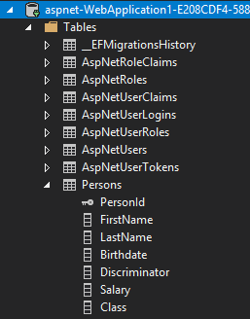
Models Inheritance (Table-Per-Hierarchy) … continued
The previous code will save Employees and Students in the SAME table with a discriminator column. After you apply database migration, the database table created will be:

Slide 13
Models Inheritance (Table-Per-Type)
Now, consider the following code
public class ApplicationDbContext : IdentityDbContext
{
public DbSet<Employee> Employees { get; set; }
public DbSet<Student> Students { get; set; }
public ApplicationDbContext(DbContextOptions<ApplicationDbContext> options)
: base(options) {}
}
public abstract class Person
{ // No primary key required here, contrast to the previous example (Table-Per-Hierarchy)
public string FirstName { get; set; } public string LastName { get; set; }
public DateTime Birthdate { get; set; }
}
// You must include EmployeeId and StudentId else migration will fail without Primary Key!
public class Employee : Person public class Student : Person
{ {
public int EmployeeId { get; set; } public int StudentId { get; set; }
public double Salary { get; set; } public string Class { get; set; }
} }

Slide 14
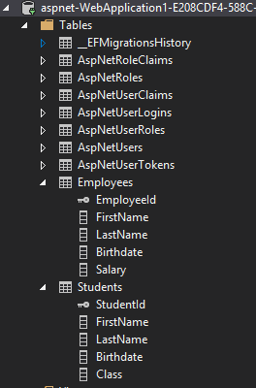
Models Inheritance (Table-Per-Type) … continued
The previous code will save Employees and Students in the separate tables. However, each table will include columns from the abstract Person class. After you apply database migration, the database table created will be:

Slide 15
Create operation with EF (SQL: INSERT)
Consider the following code:
using (var context = new ApplicationDbContext())
// or context injected by dependency injection
{
var supplier = new Supplier {Supplier_Name = "George"};
context.Suppliers.Add(supplier);
context.SaveChanges();
}

Slide 16
Read and Update operation with EF (SQL: SELECT, UPDATE)
Consider the following code:
using (var context = new ApplicationDbContext())
// or context injected by dependency injection
{
var supplier = context.Suppliers
.FirstOrDefault(x => x.Supplier_Name == name);
// assuming name is a method argument
supplier.Address = "Ermou 1, Syntagma, Athens";
context.SaveChanges();
}

Slide 17
Read and Delete operation with EF (SQL: SELECT, DELETE)
Consider the following code:
using (var context = new ApplicationDbContext())
// or context injected by dependency injection
{
var supplier = context.Suppliers
.FirstOrDefault(x => x.Id == id);
// assuming id is a method argument
context.Suppliers.Remove(supplier);
context.SaveChanges();
}

Slide 18
Reading data operation with EF (SQL: SELECT)
Consider the following code:
using (var context = new ApplicationDbContext())
{
var suppliers = context.Suppliers.ToList(); // Load all data
// Load a single supplier with Id 1 - Single vs First ???
var supplier = context.Suppliers.Single(s => s.Id == 1);
// Load suppliers based on filters
var suppliers = context.Suppliers
.Where(s => s.Address.Contains("Athens")
.ToList(); // Materialize Query (e.g. execute on SQL)
}

Slide 19
Querying with LINQ Lambda Expressions
Consider the following code:
using (var context = new ApplicationDbContext())
{
var suppliers = context.Suppliers.ToList(); // Load all data
// Load a single supplier with Id 1 - Single vs First ???
var supplier = context.Suppliers.Single(s => s.Id == 1);
// Load suppliers based on filters
var suppliers = context.Suppliers
.Where(s => s.Address.Contains("Athens")
.ToList(); // Materialize Query (e.g. execute on SQL)
}

Slide 20
Sorting and Paging with LINQ Lambda Expressions
Consider the following code:
using (var context = new ApplicationDbContext())
{
// Sort by supplier_name (OrderByDescending sorts descending)
var query = context.Suppliers.OrderByDescending(s => s.Supplier_Name);
// Paging
var pagedQuery = context.Suppliers.OrderBy(s => s.Id).Skip(2).Take(2);
}
More at: https://docs.microsoft.com/en-us/dotnet/api/system.linq?view=netframework-4.8

Slide 21
Grouping with LINQ Lambda Expressions
Consider the following code:
using (var context = new ApplicationDbContext())
{
var pquery = products.GroupBy(
p => p.Producy_Category.Category_Name,
(newProduct, prods) => new
{
Key = newProduct,
Count = prods.Count()
}
);
foreach(var res in pquery)
{
Console.WriteLine($"Category:{res.Key} - Count: {res.Count}" );
}
}

Slide 22
Handling Concurrency conflicts with EF
When creating your model, you can use two Concurrency token attributes [Timestamp] and [ConcurrencyCheck] in order to configure specific properties to be checked against changes by another user when Save is called. For example you can have properties like:
[Timestamp]
public byte[] Timestamp { get; set; }
[ConcurrencyCheck]
public string IBAN {get; set;}
Both properties will be checked if changed from the last time they were loaded from the DB into a memory object when a Save operation (SQL: UPDATE) is performed with EF. If a concurrency conflict is detected, then a DbUpdateConcurrencyException is raised!
By default properties are NEVER used as concurrency tokens, except when configured.
Depending on your application’s strategy, you may want to preserve the original values or keep the current values.
Let’s study the example in: https://docs.microsoft.com/en-us/ef/core/saving/concurrency

Slide 23
Database Transactions with EF
Definition: A transaction is a set of DB operations that will be performed in an atomic manner (e.g. ALL operations will be committed to the database OR if something fails ALL operations will be rollbacked, leaving the DB in a consistent state).
By default context.SaveChanges() applies all DB changes in a transaction, meaning that if an error occurs the database will be unmodified!
Example of controlling transactions yourself:
using (var context = new ApplicationDbContext()) {
using (var transaction = context.Database.BeginTransaction()) {
try {
context.Suppliers.Add(new Supplier { Supplier_Name = “Maria” });
context.SaveChanges();
context.Products.Add(new Product { Product_Name = “Sony TV”,
Supplier = context.Suppliers.Single(s => s.Id == 1) } );
transaction.Commit();
} catch (Exception ex) { // TODO: Handle problem }
}
}

Slide 24
Sending Raw SQL Queries
Sometimes it is useful to send raw SQL Queries to the database, instead of using EF. Some examples:
using (var ctx = new SchoolDBEntities())
{
// Send an SQL query and translate to entity (Blogs model should be similar to the table columns)
var blogs = ctx.Blogs.FromSqlRaw("SELECT * FROM dbo.Blogs").ToList();
// Execute a stored procedure with parameters
var blogs = ctx.Blogs.FromSqlRaw("EXECUTE dbo.GetMostPopularBlogsForUser {0}", user) .ToList();
// Execute an SQL Command
int noOfRowDeleted = ctx.Database.ExecuteSqlCommand("DELETE FROM Students WHERE StudentId=1");
}

Slide 25
RDBMS vs NoSQL
RDBMS systems like SQL Server or MySQL, organize data in Tables. NoSQL systems like MongoDB organize data in collections. In RDBMS we usually refer to an entity as a “Record” while in NoSQL we refer to a “document”.
In RDBMS you can relate a record with another record in the same or another table. NoSQL systems in general do not provide relationships! There are workarounds to this: https://docs.mongodb.com/manual/tutorial/model-referenced-one-to-many-relationships-between-documents/
When you modify a schema in RDBMS (you add or remove a table columns), all records in this table are affected. In NoSQL systems, you can have unstructured data (not all records having the same number of columns).
In RDBMS you can enforce constraints: Default values, Required fields etc. In NoSQL systems you have to enforce constraints on your code OR define a validation schema: https://docs.mongodb.com/manual/core/schema-validation/
If you don’t define a validation schema, then you can have 2 different documents in the same collection where a field in document 1 can be of a different type than the same field name on document 2. For example:
{ _id: ObjectId(“542c2b97bac0595474108b48”), name: “Thanasis Maikousis” }
{ _id: ObjectId(“542c2b97bac0595474108b49”), name: 20 }

Slide 26
THANK YOU

